Slide 1

Proofs
By Ariel Avshalom
Lecture 1
CISC 2210

Slide 2
What are proofs?
Traditionally, mathematics was created to understand concepts like numbers, magnitude (size) and form
The great thinkers of the classical era were able to explain and even demonstrate the validity of various natural phenomena in nature

Slide 3
But they couldn’t rigorously define the truth of most of their observations

Slide 4
That’s where proofs come in…
Observations of natural phenomena
PROOFS
A way to dissect and examine natural phenomena
A rigorous method to show the validity of observations

Slide 5
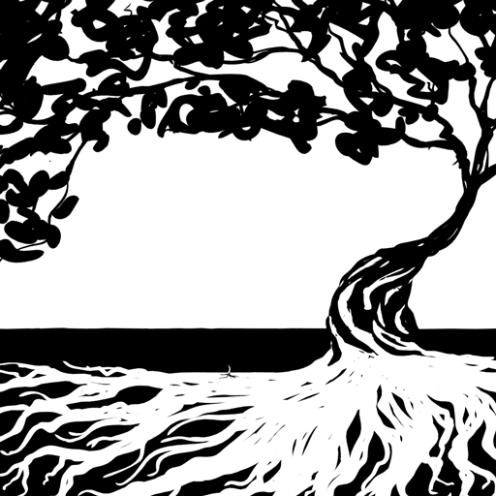
The concept of a proof
A proof is the evidence which compels the acceptance of a fact as truth
Given some definition(s) or axiom, construct by inference, a theorem which states something new
Then, build up those theorems and eventually you’ll build MATH

Slide 7
A Historical Perspective
particularly because the demonstrative nature of geometry allowed for the easy conceptualization of ideas
Proofs started with geometry
As is usually the case in math, the earliest known origin is in Classical Greece

Slide 8
Euclid’s Elements
The Greek mathematician Euclid of Alexandria brought proofs (into and) out of geometry and into what we’re studying today
He wrote a book called Euclid’s Elements which conceptualized proofs in the axiomatic method:

Slide 9
The axiomatic method
Start with several unknown definitions and axioms
Make inferences about some new concept
Show those inferences are true because of some evidentiary reason
Push your inferences to the stated goal (the unknown definition) using deductive logic
Append a Q.E.D or ☐ to end

Slide 10
Logic

Slide 11

After the Greeks
Proofs advanced further during the Islamic golden age with the development of arithmetic and algebra
These proofs didn’t rely on the notions of intuitive geometry
They focused on number theory and there is even a proof which shows that the $√2$ is irrational

Slide 12
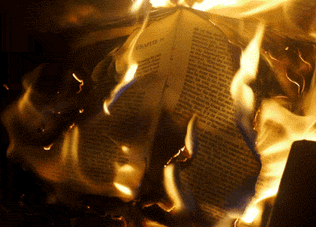
Remember the definitions!
Definitions are really really really REALLLY important
They are the basis of any proof and you need to have them down
You can write a whole book of beautiful proofs but it can all be incorrect because of one mistake on the first page

Slide 13
Some definitions
Axiom: something that is obviously true
Theorem: a mathematical statement that can be proven to be true
Proof: a written verification of a theorem
Definition: an exact, unambiguous explanation of the meaning of a mathematical word or phrase

Slide 14
The difference between math and other sciences (An XKCD explanation)

Slide 15
Definitions from the book:
Definition 8.1:
An integer n is even if n = 2a for some integer a ∈ Z.
Definition 8.2
An integer n is odd if n = 2a+1 for some integer a ∈ Z.
Definition 8.3
Two integers have the same parity if they are both even or they are both odd. Otherwise they have opposite parity.
Definition 8.5
A natural number n is prime if it has exactly two positive divisors, 1 and n.

Slide 16
A nuance that the book absconds
Fact 8.1
Suppose a and b are integers.
Then:
a + b ∈ Z
a − b ∈ Z
ab ∈ Z
Are all true because the integers are closed under addition, subtraction and multiplication
We call sets that are closed under addition, subtraction, multiplication and division (plus a bunch of other requirements) a field

Slide 17
Direct Proofs
Begin with a given statement
1
Infer based on that statement
2
Show that what you want to prove is true
3

Slide 18
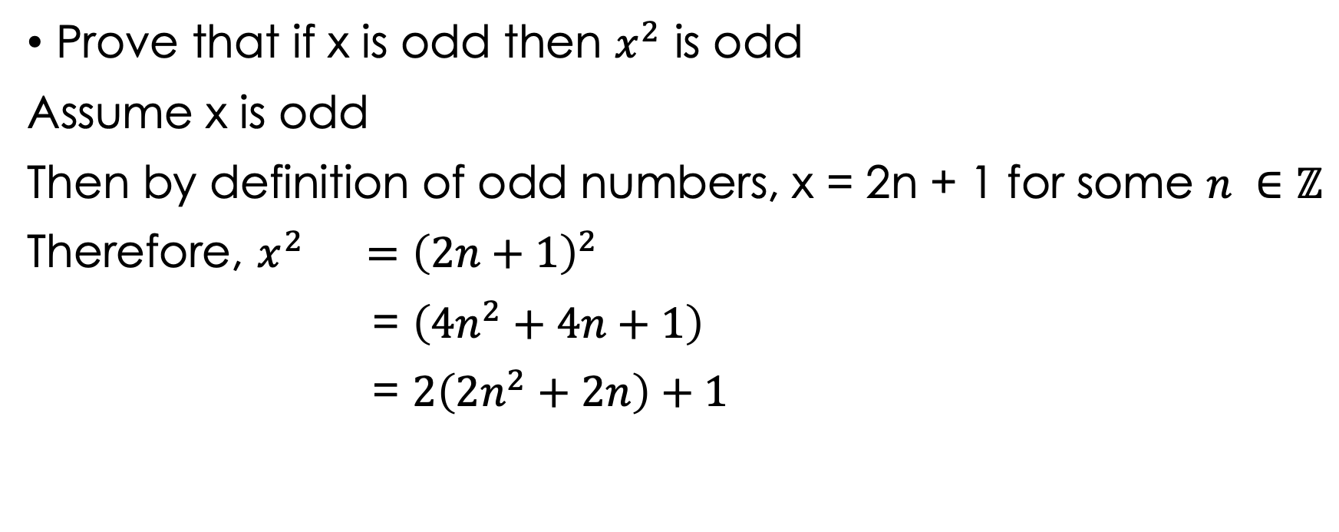
Example
Prove that if x is odd then $x^{2}$ is odd
Assume x is odd
Then by definition of odd numbers, x = 2n + 1 for some $n ∈\text{ℤ}$
Therefore, $x^{2} ={\left(2n+1\right)}^{2}$
= $\left(4n^{2}+4n+1\right)$
= $2\left(2n^{2}+2n\right)+1$
even
odd

Slide 19
What are proofs?
Traditionally, mathematics was created to understand concepts like numbers, magnitude (size) and form
The great thinkers of the classical era were able to explain and even demonstrate the validity of various natural phenomena in nature, but they couldn’t rigorously define the truth of most of their observations
That’s where proofs come in…discovering a rigorous way to show that an idea is true or false

